Slide 1
Hot Streaks on Social Media
Kiran Garimella, Robert West

Slide 2
Hot streaks

Slide 3
Hot streak
“A period during which an individual’s performance is substantially higher than her typical performance.”
Notes:
As Kobe Bryant says..

Slide 4

Hot streaks in science
Bursts of high-impact works occurring in sequence.
Notes:
Also exist in financial markets and gambling
We found different characteristics compared to science and I’d be happy to discuss during the questions.

Slide 5
Hot hand in gambling

Slide 6
This paper
Are there hot streaks on social media?

Slide 7
Hot Streaks on Social Media
Looking at trends in retweet count during the career of a social media user.
Are there periods of increased retweet counts?
Does the most retweeted tweet occur in isolation?

Slide 8
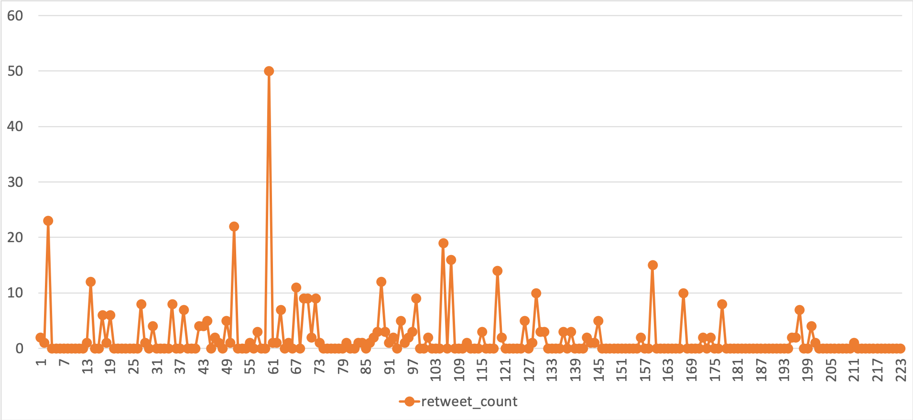
Careers on Social Media
@gvrkiran
Retweet count
Tweet index
*Only original tweets
Notes:
Countries like myanmar and sri lanka it is a necessity

Slide 9
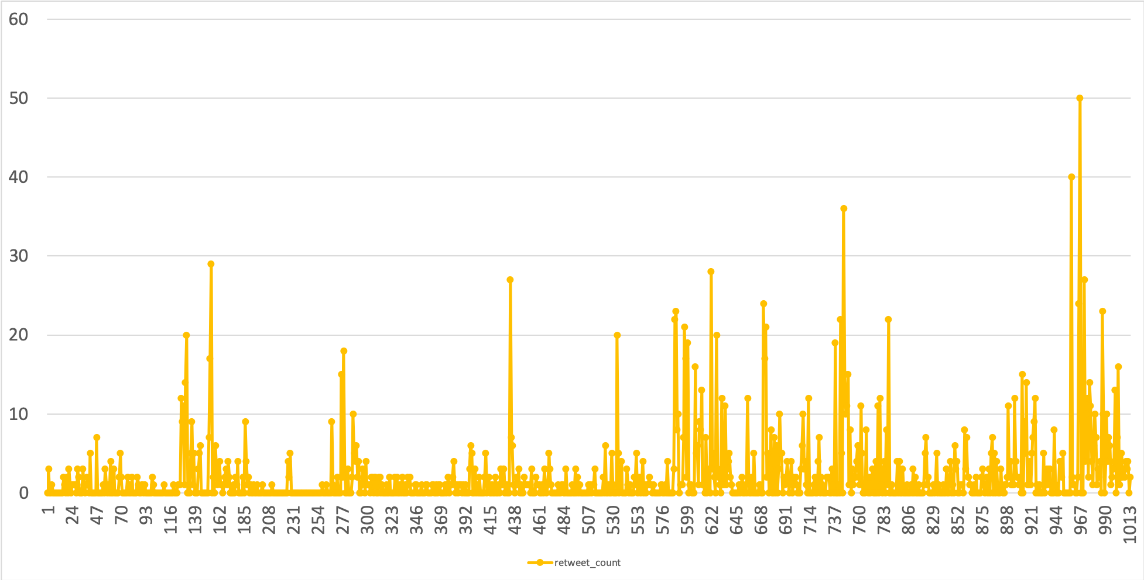
Careers on Social Media
@icwsm
Retweet count
Tweet index
*Only original tweets

Slide 10
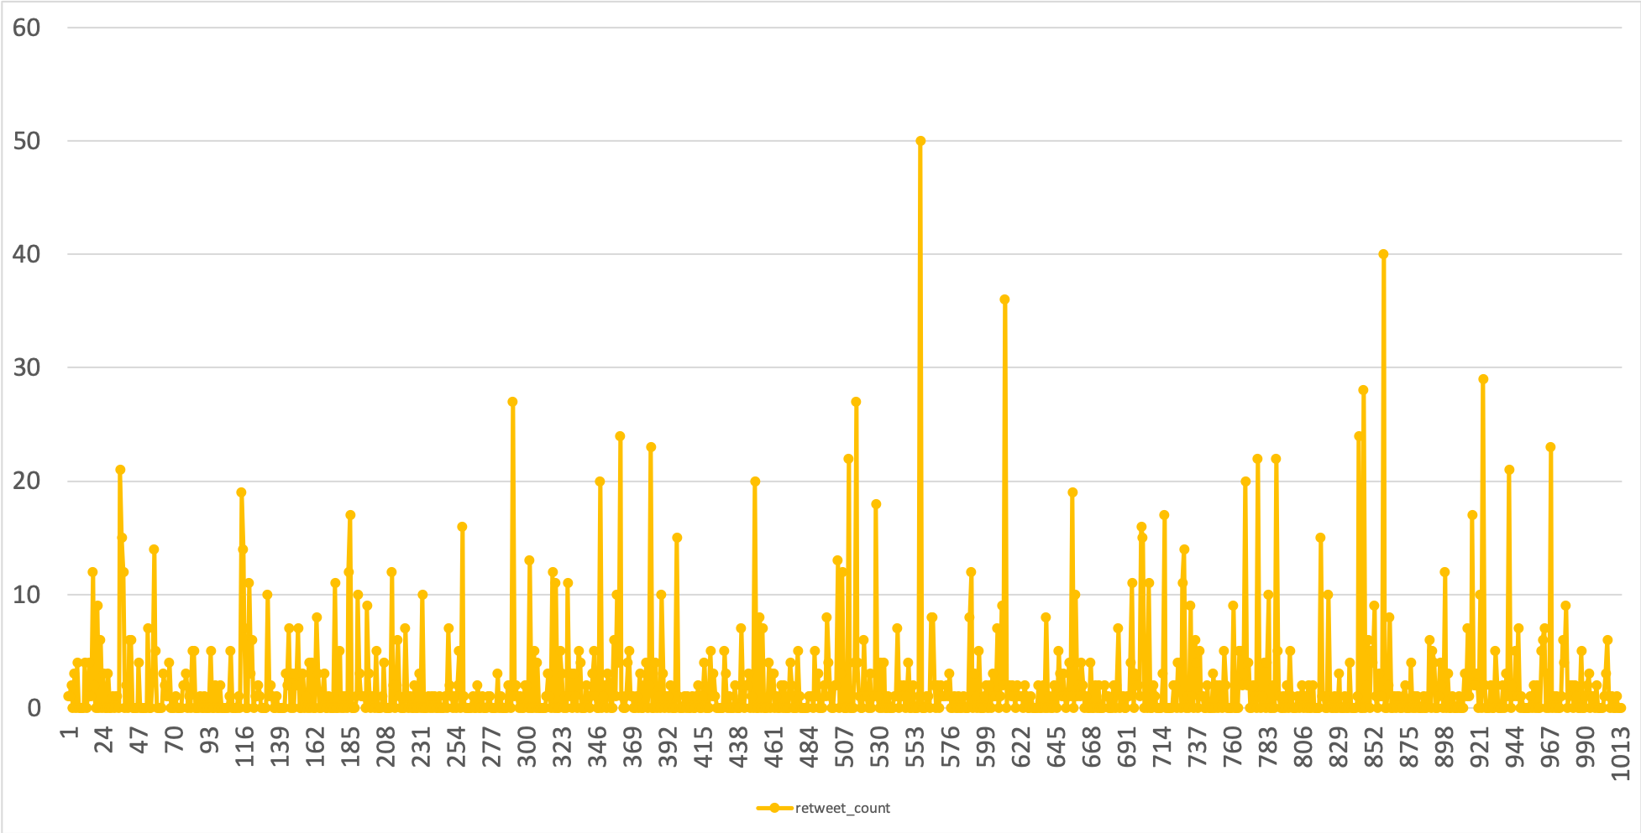
Shuffled Careers
@icwsm
@icwsm (shuffled)
Retweet count
Tweet index
*Only original tweets
Notes:
Countries like myanmar and sri lanka it is a necessity

Slide 11
Findings
First, impact is clustered in time, such that the most impactful tweets of a user appear close to each other.
Second, users commonly have “hot streaks” of impact, i.e., extended periods of high- impact tweets.
Third, impact tends to gradually build up before, and fall off after, a user’s most impactful tweet.

Slide 12
Datasets
4 datasets on Twitter.
Different contexts, sampling.
Data | Num. users | Median followers | Total tweets
Verified | 2,710 | 105,007 | 5.3M
Political | 10,563 | 360 | 22.3M
Random1 | 76,777 | 606 | 130M
Random2 | 5,465 | 515 | 7.9M

Slide 13
Position of the most retweeted tweet
@icwsm
967
961
Retweet count
Tweet index
Notes:
Countries like myanmar and sri lanka it is a necessity

Slide 14
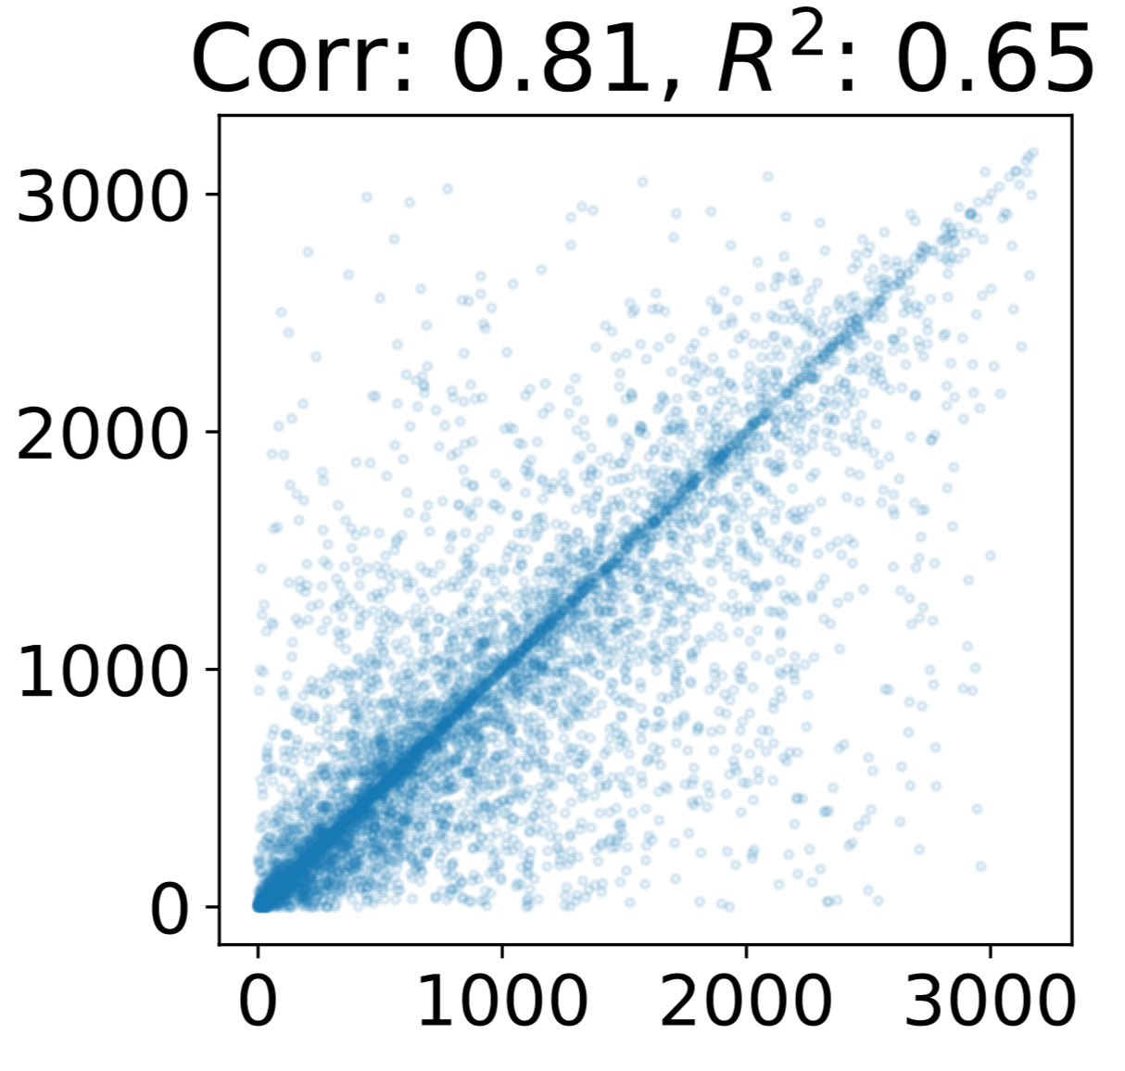
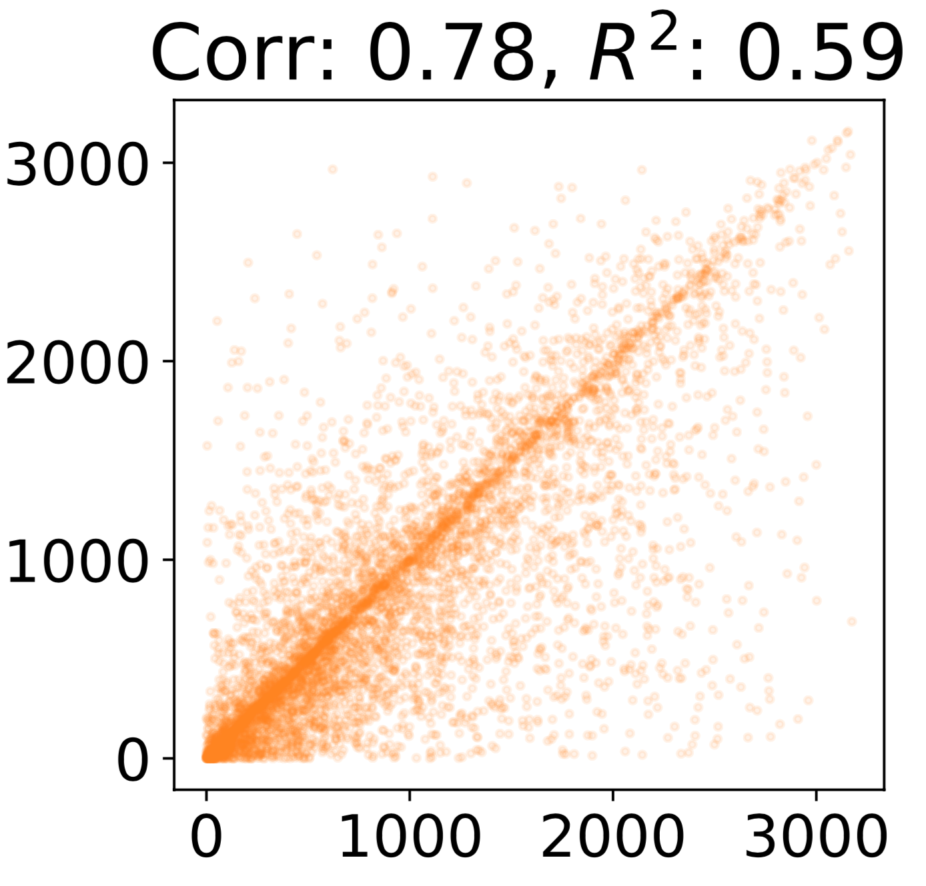
Position of the most retweeted tweet
Position of the second most retweeted tweet
Position of the third most retweeted tweet
Position of the first most retweeted tweet
Position of the first most retweeted tweet
Notes:
Mention that every user has at least 2000 tweets.

Slide 15
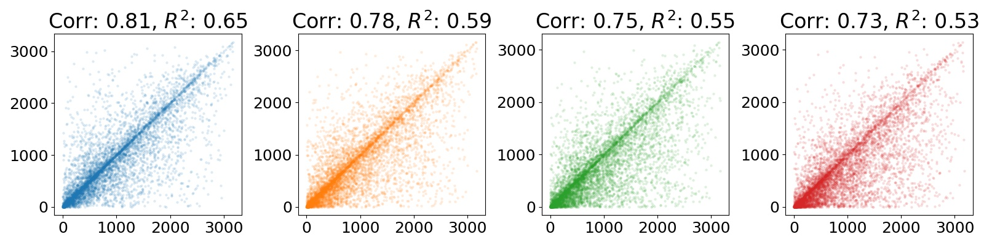
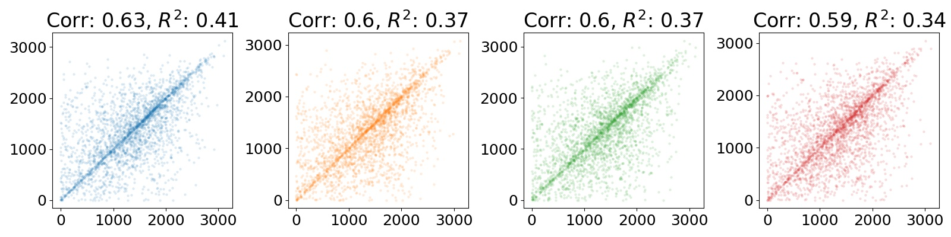
Position of the most retweeted tweet
First vs. Second
First vs. Third
First vs. Fourth
First vs. Fifth

Slide 16
Position difference
@icwsm
967
= (967-961)/1013
961
Retweet count
Tweet index
Notes:
Countries like myanmar and sri lanka it is a necessity

Slide 17
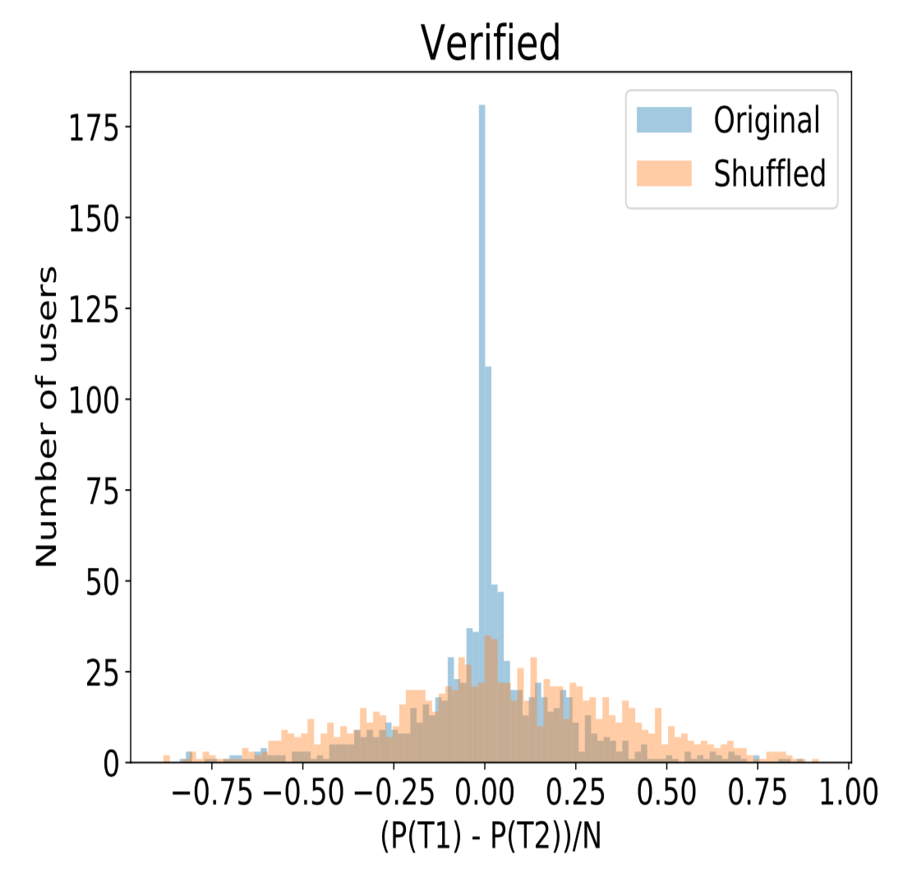
Position difference
Verified

Slide 18
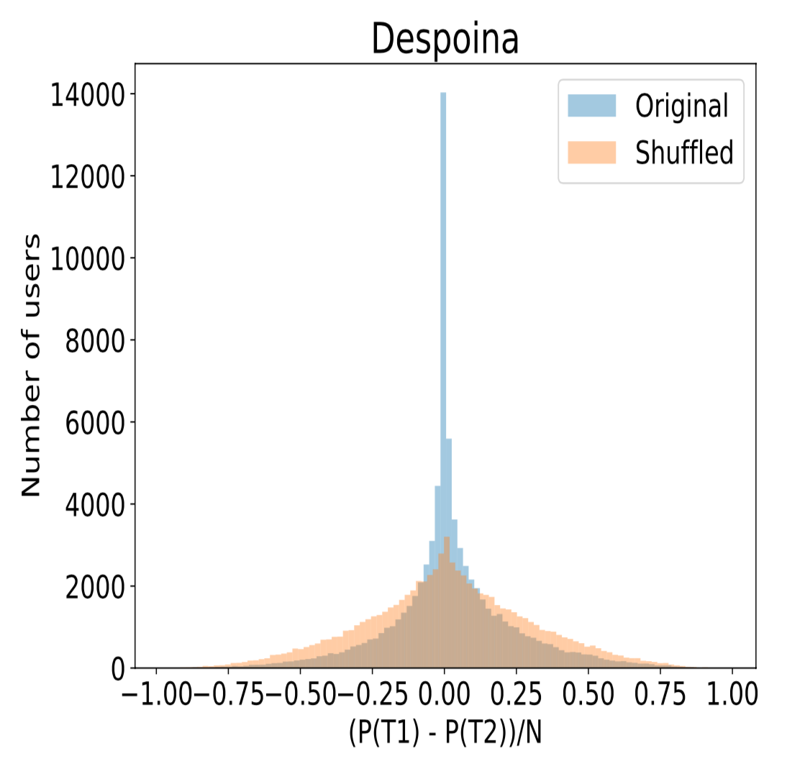
Position difference
Verified
Random1

Slide 19
Does it generalize?
Do such highly retweeted tweets occur within extended periods?

Slide 20
Hot Streaks
Identify periods of consistently high retweet counts in the career time series.
Notes:
The dashed green horizontal line shows the 90th percentile.

Slide 21
Hot Streaks

Slide 22
Multiple hot streaks
Notes:
Greater than 10 tweets at least.

Slide 23
How common are hot streaks on social media?
Hot streaks are quite prevalent in our datasets.
At least 60% of the users in each dataset have at least one hot streak.
Most users have 3-4 hot streaks during their career.
Typically around 20-30 tweets long.

Slide 24
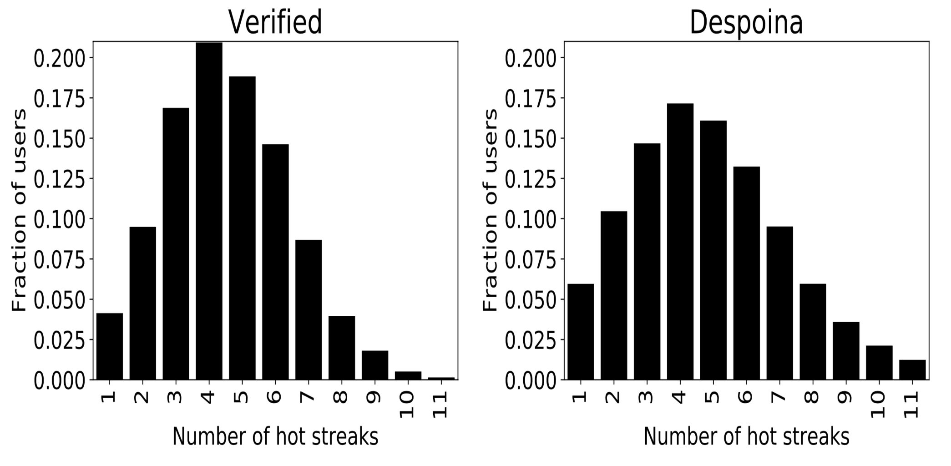
Number of hot streaks
Verified
Random1

Slide 25
What happens during a hot streak?

Slide 26
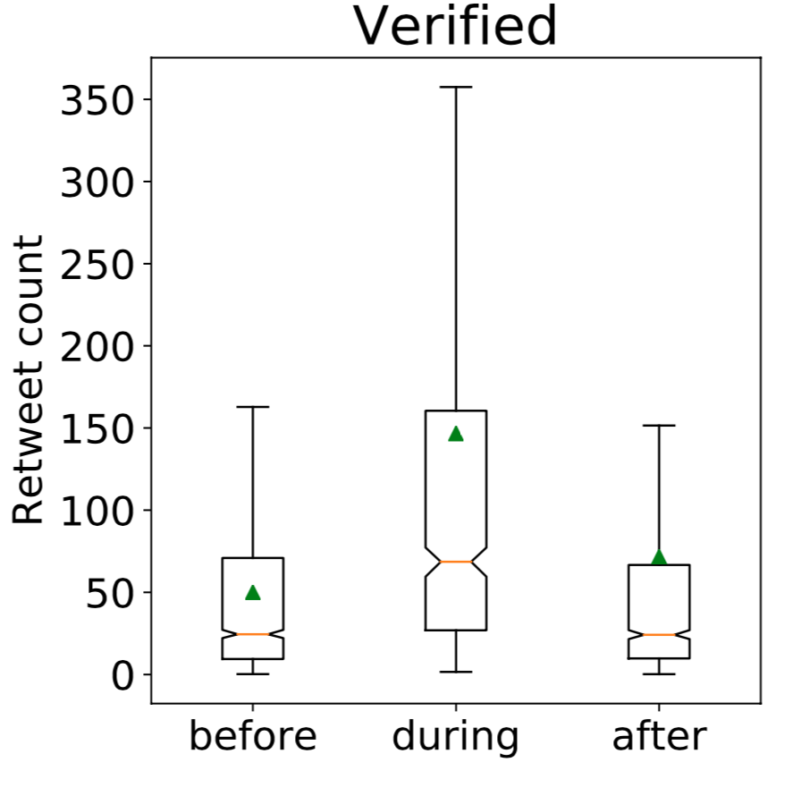
Retweet count
After > Before
Notes:
Mean is green triangle, median is the orange line

Slide 27
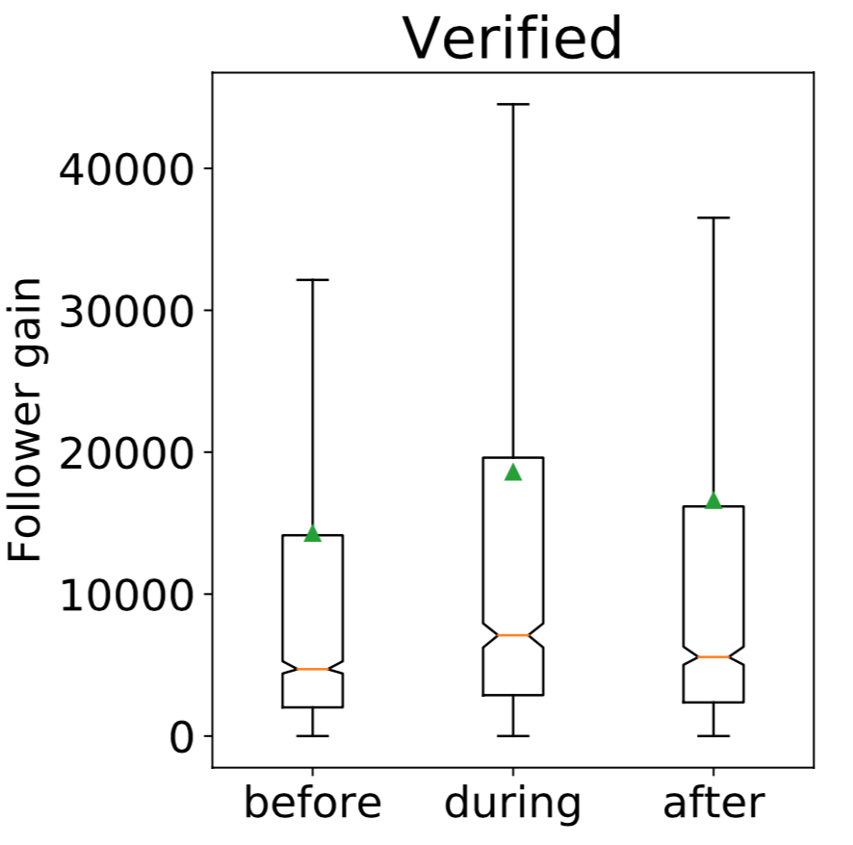
Follower gain
After > Before

Slide 28
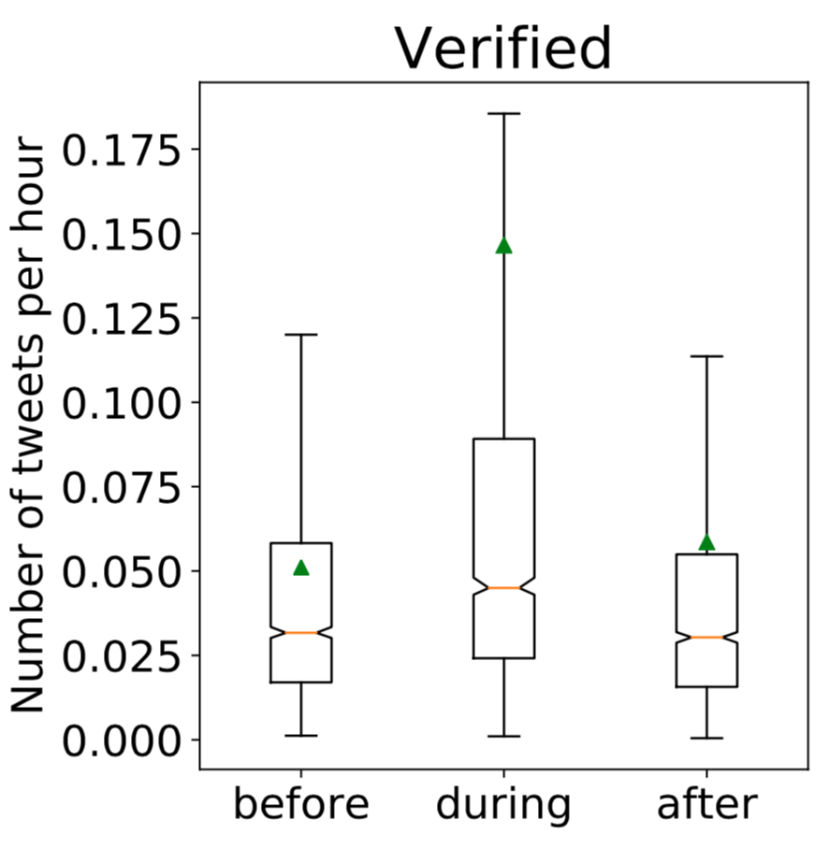
Activity

Slide 29
During a hot streak
Higher retweet count, lasting effect.
An increased follower gain, lasting effect.
And an increase in activity.

Slide 30
Why is this happening?
Network – behavior of retweeters and followers
Content – what the user is posting
Activity – number and type of tweets the user is posting
Notes:
Factors affecting hot streaks

Slide 31
Why is this happening? -- Network
We fix the set of retweeters who retweeted the user before a hot streak and tracked their activity during and after the hot streak.
These retweeters retweet the user significantly less during a hot streak.
Driven mostly by new retweeters.
Who start retweeting the user suddenly, but lose interest quickly.

Slide 32
Content and Activity
Content features: entropy, sentiment, etc.
Activity features.
Notes:
: entropy of the tweet in terms of the word distribution, entropy of the topic distribution, and average sentiment of tweets.
fraction of tweets that are retweets/replies/mentions; fraction of tweets containing media/URLs/hashtags; tweet length;

Slide 33
Content and Activity
Higher fraction of tweets that are retweets or contain media
Lower fraction of tweets that are replies/mentions
Longer tweets, with higher entropy both in terms of words and topics
No change in sentiment.

Slide 34
Content/Activity vs. Network
Filter users for whom there was no change in their follower network.
Many trends in content and activity still persist.
Users exhibit a strong change in how they act and how they produce content during a hot streak.

Slide 35
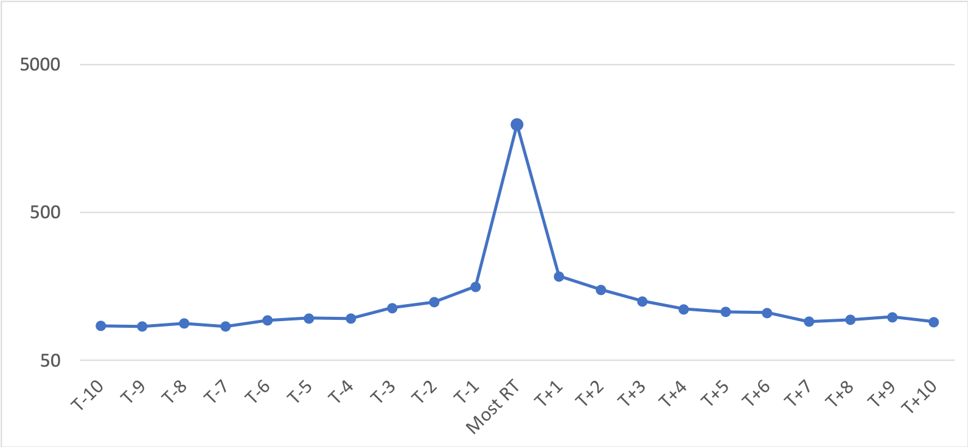
What happens around the most retweeted tweet?
Mean retweet count
Notes:
Stark difference to science, where the impact is random.

Slide 36
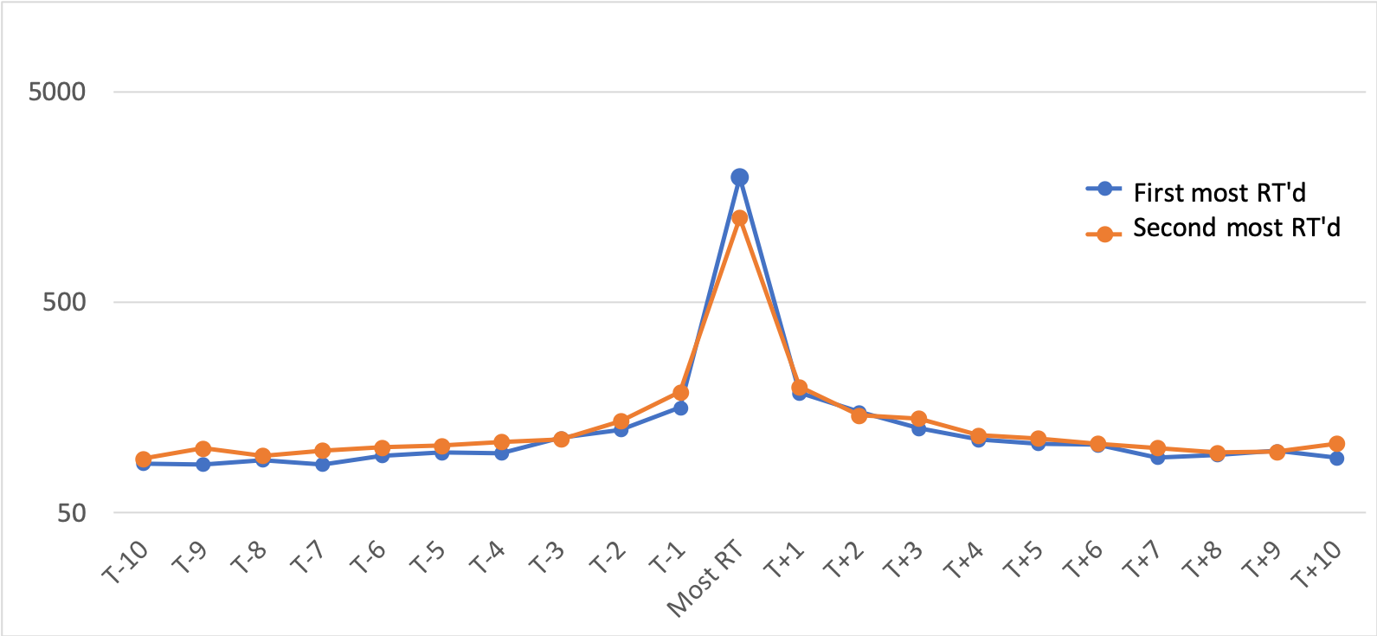
What happens around the most retweeted tweet?
Mean retweet count

Slide 37
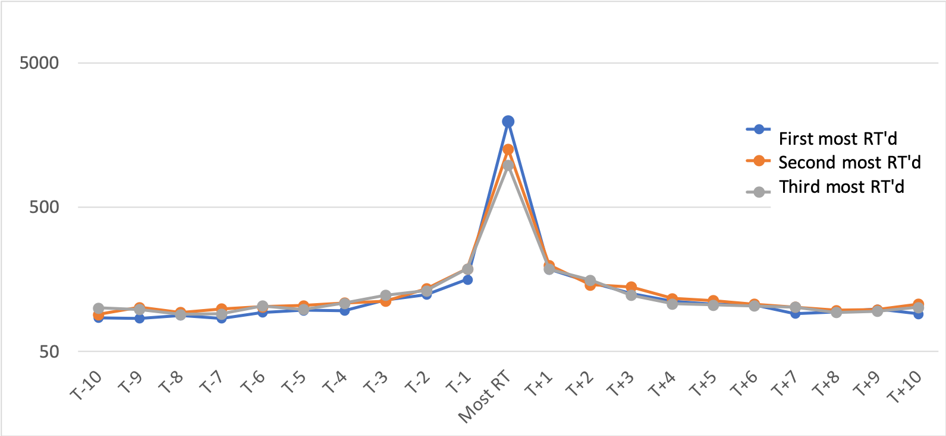
What happens around the most retweeted tweet?

Slide 38
What happens around the most retweeted tweet?
Mean retweet count

Slide 39
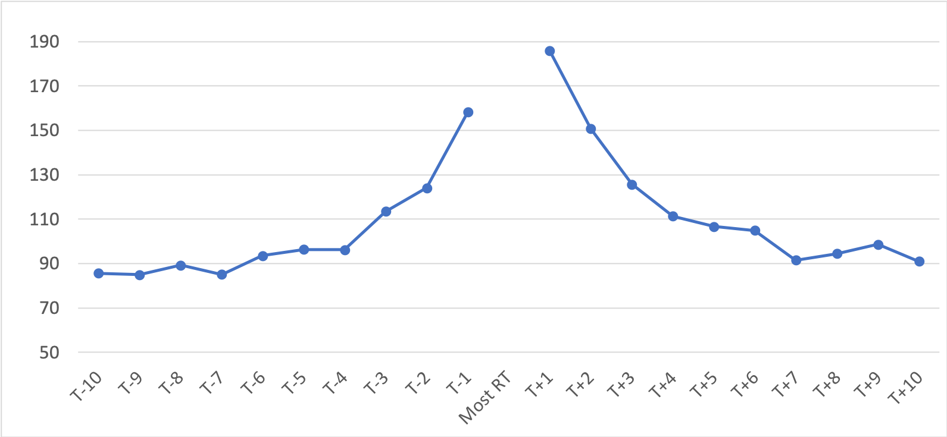
What happens around the most retweeted tweet?

Slide 40
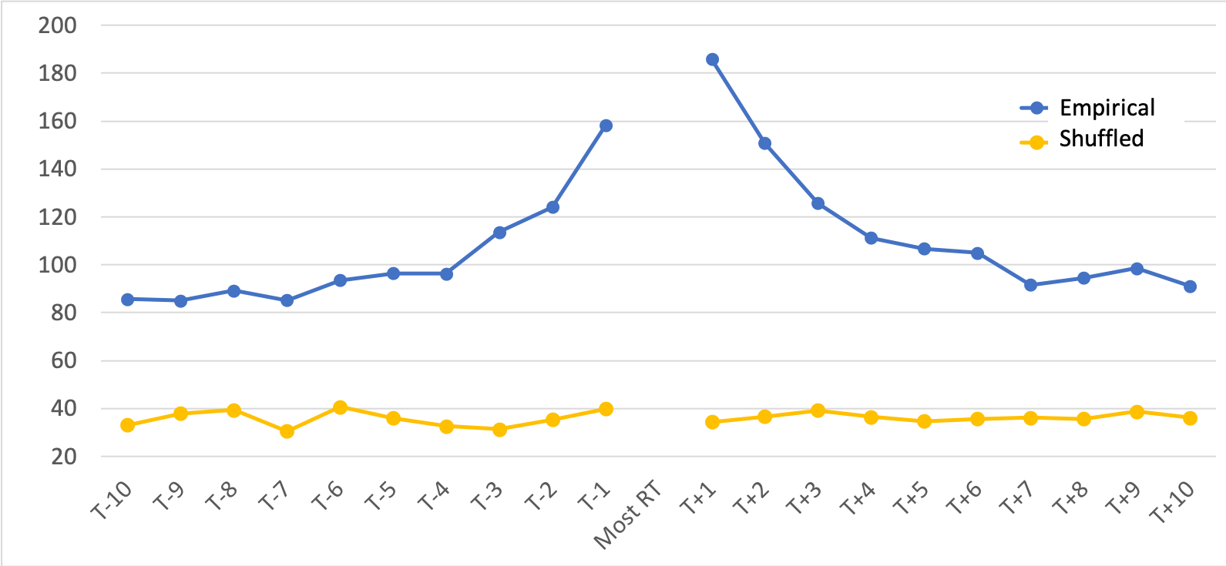
What happens around the most retweeted tweet?

Slide 41
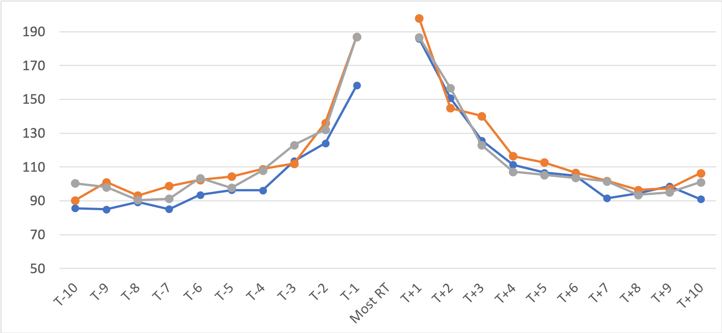
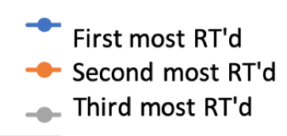
What happens around the most retweeted tweet?

Slide 42
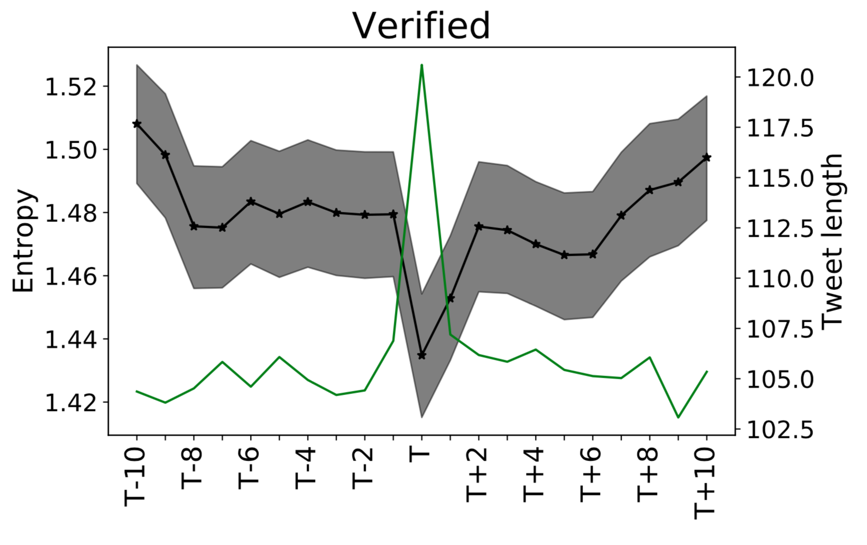
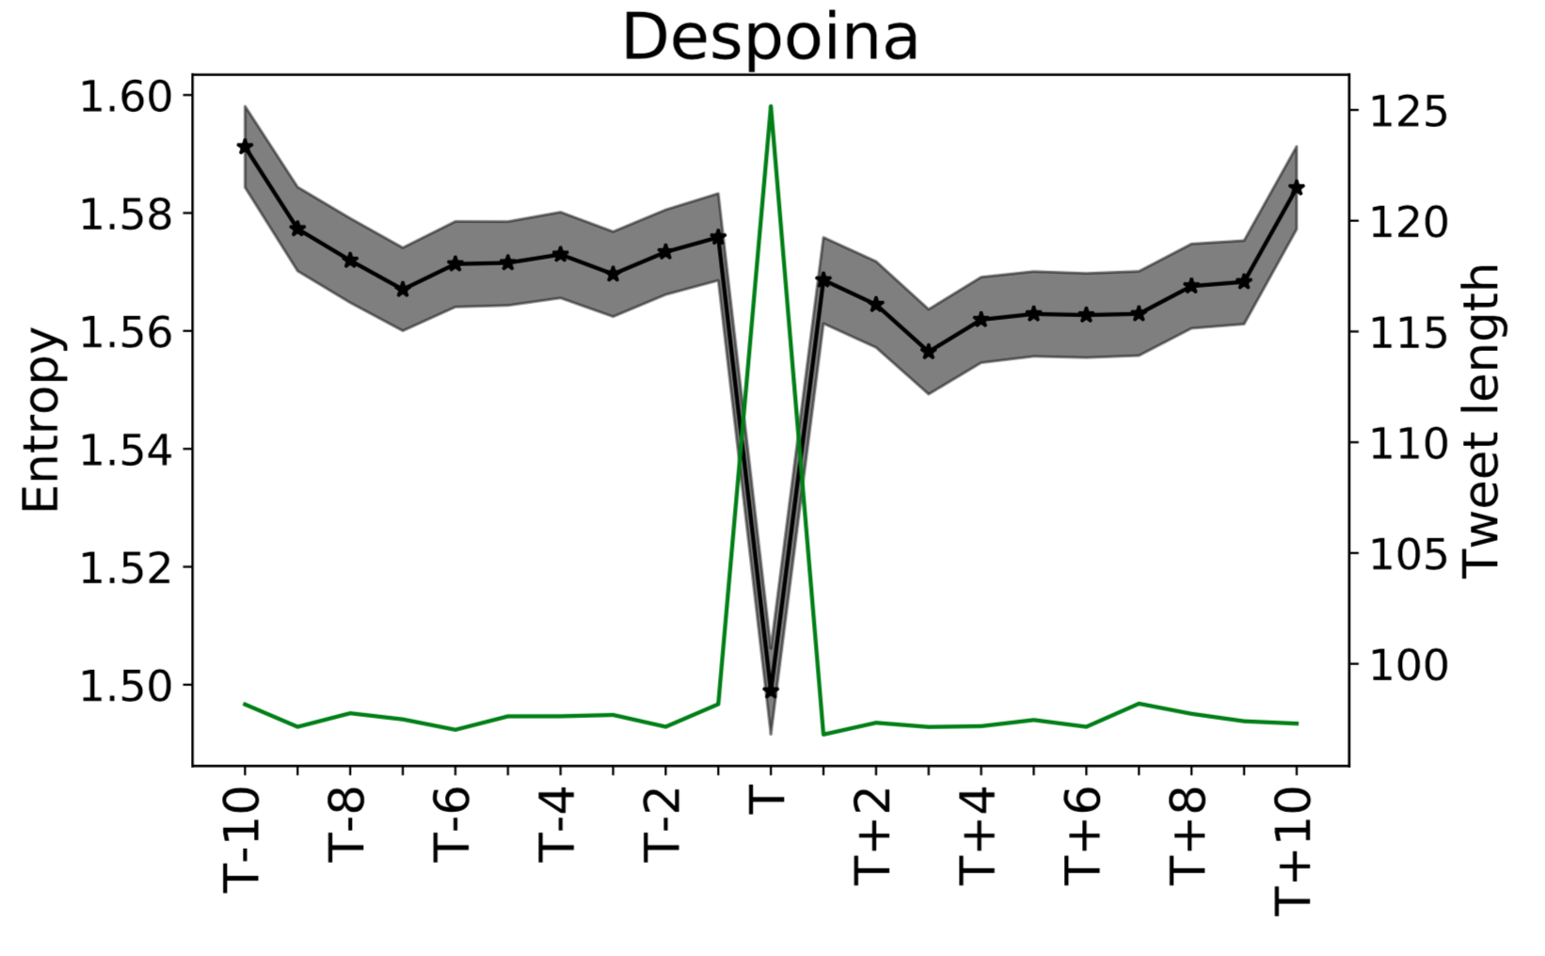
Why is this happening?
Entropy of the topic distributions (black)
Vs. Tweet length (green, 2nd y-axis)
Most retweeted
Most retweeted

Slide 43
Findings
First, impact is clustered in time, such that the most impactful tweets of a user appear close to each other.
Second, users commonly have 'hot streaks' of impact, i.e., extended periods of high-impact tweets.
Third, impact tends to gradually build up before, and fall off after, a user's most impactful tweet.

Slide 44
Summary
Showed peculiar trends in retweet count (impact) on social media.
Existence of hot streaks on social media
Revealing several fundamental patterns that govern individual careers.

Slide 45
Thank you!
Data: https://github.com/gvrkiran/hot-streaks-social-media
@gvrkiran, garimell@mit.edu
@cervisiarius, robert.west@epfl.ch

Slide 46
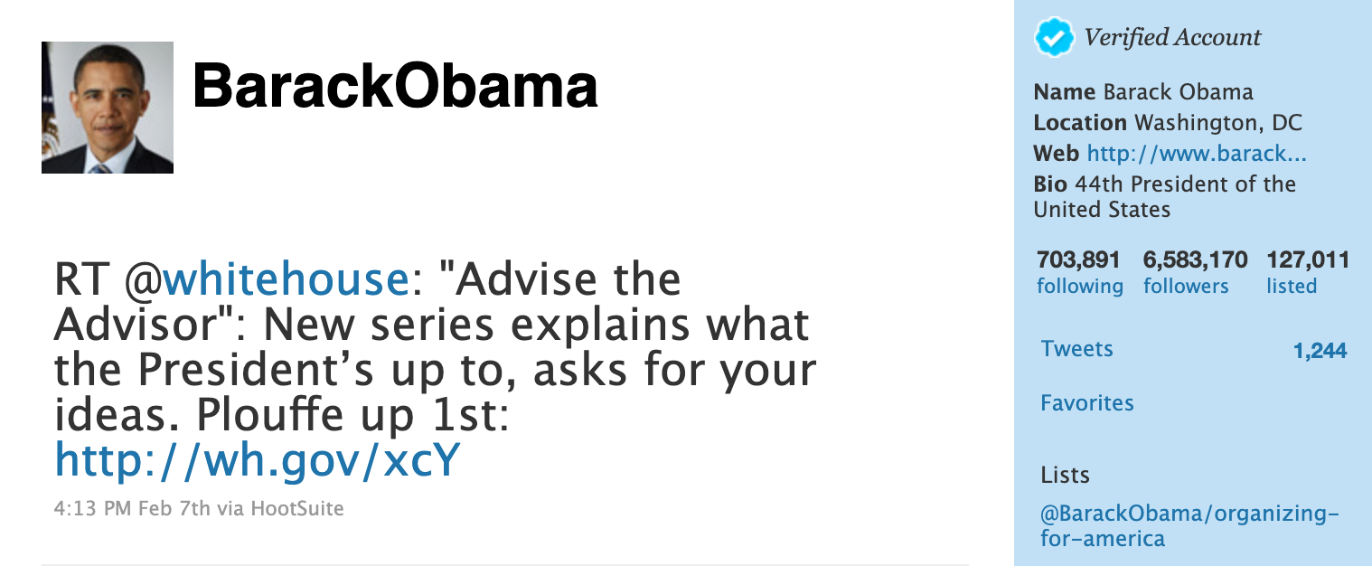
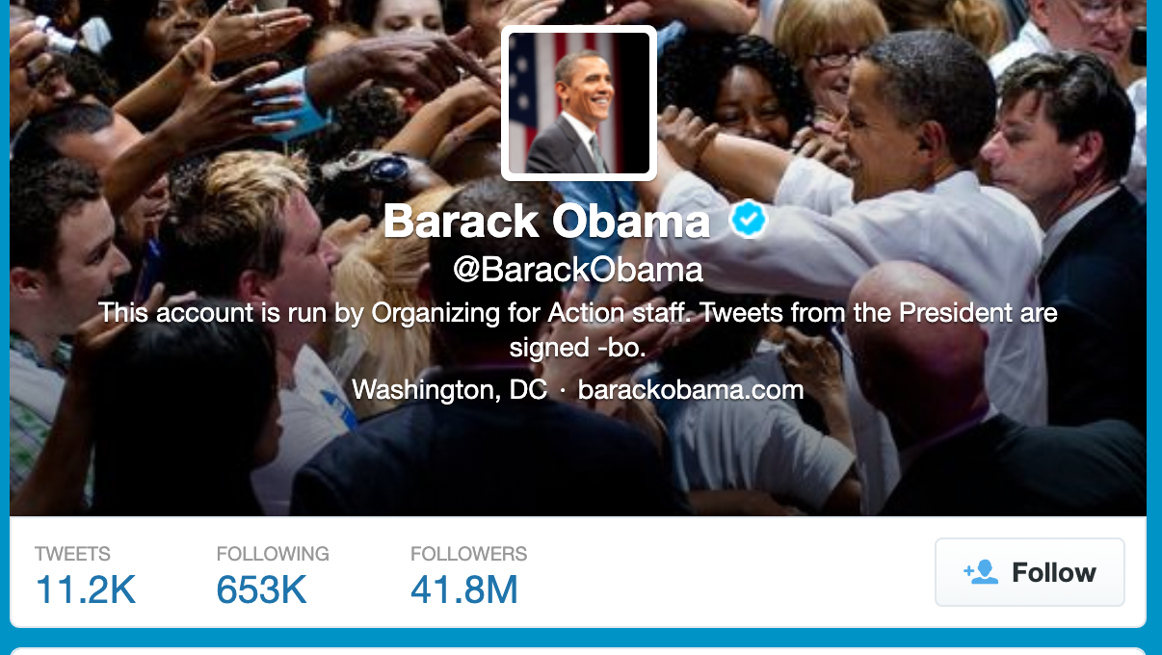
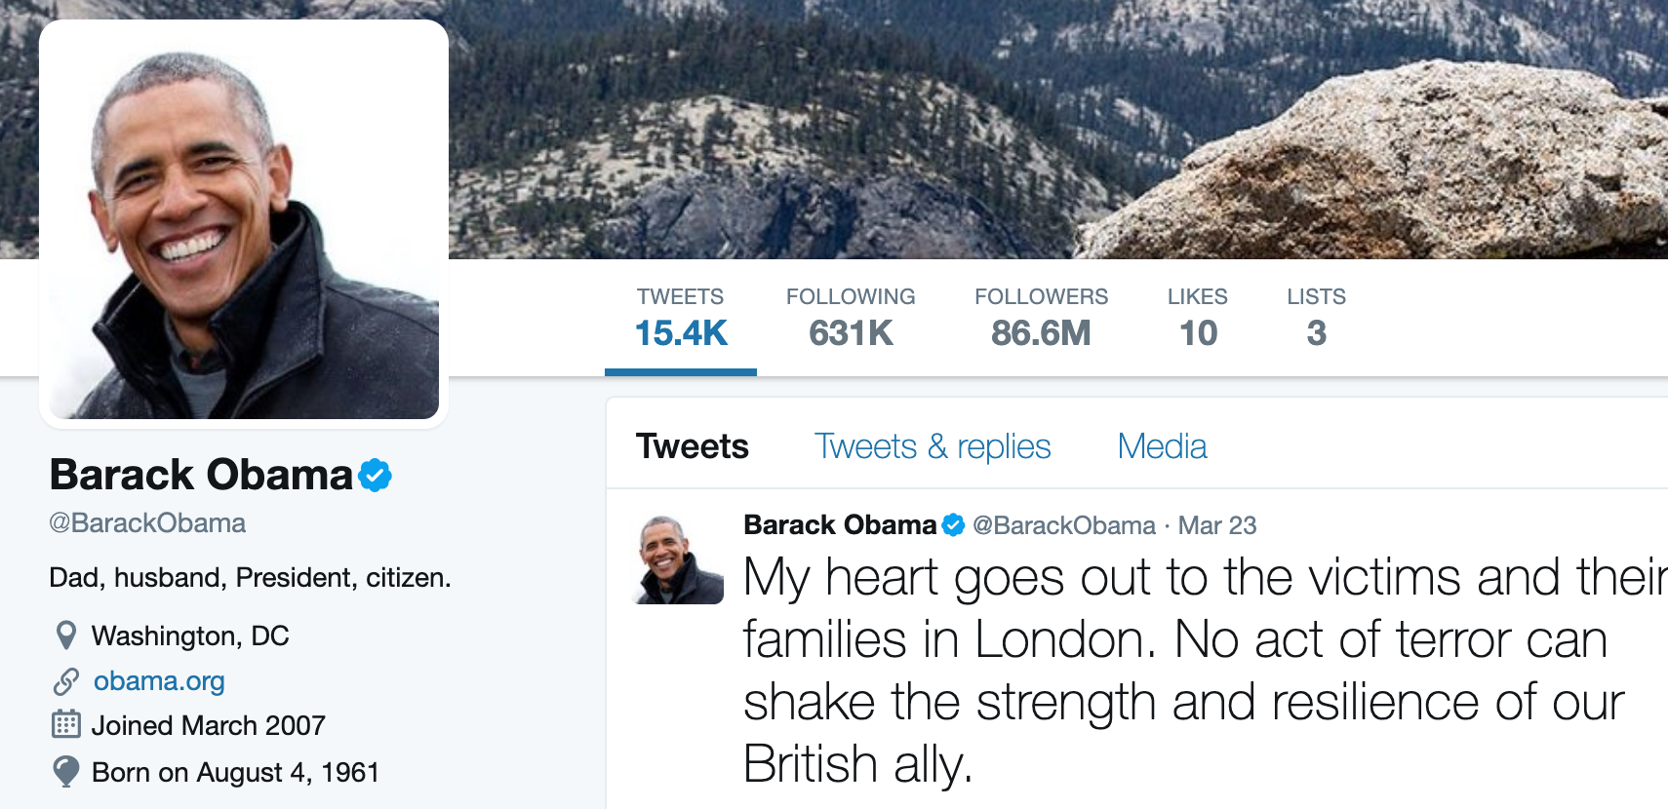
2011
2013
2017

Slide 47
